Slide 1
BBB

Slide 2


Introduction
Barabasi - Albert Model:
Scale free
Power law
Hubs
Growth and Preferential Attachment

Slide 3
Discrepancy:
Nodes which come in later can also take over in reality

Slide 4

Bianconi Barabasi Model
Each node has a “Fitness”
Later nodes with high fitness can become hubs

Slide 5
Research question
How fitness distribution impacts the Bianconi-Barabasi degree distribution?
Can we estimate real-world network fitness distribution from node degree evolution?
Can we retrieve the phase transition where the topology of the network changes?

Slide 6
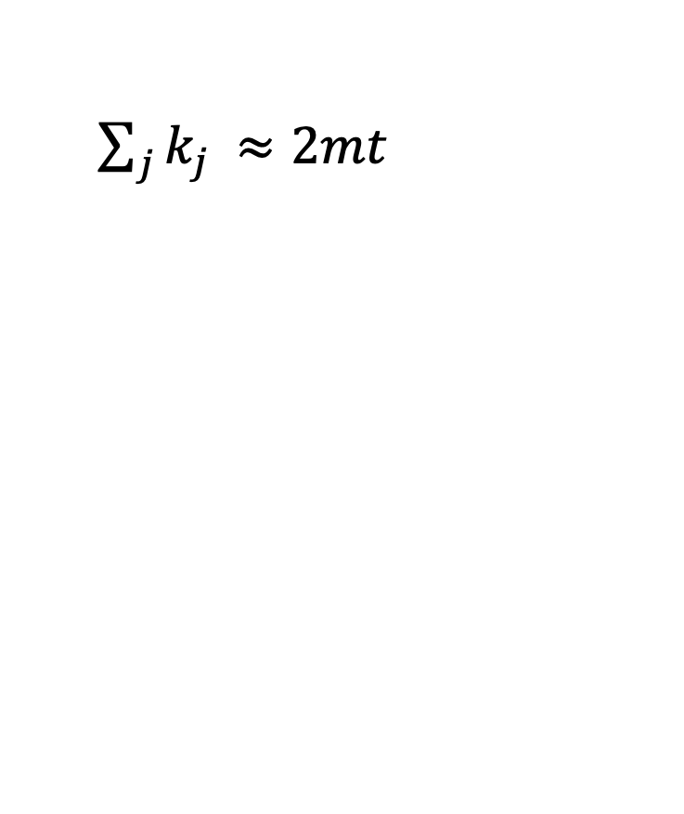
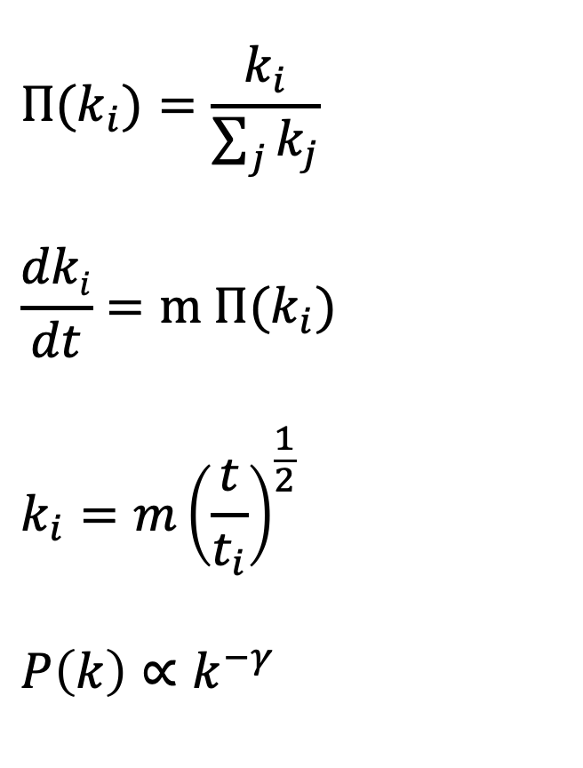
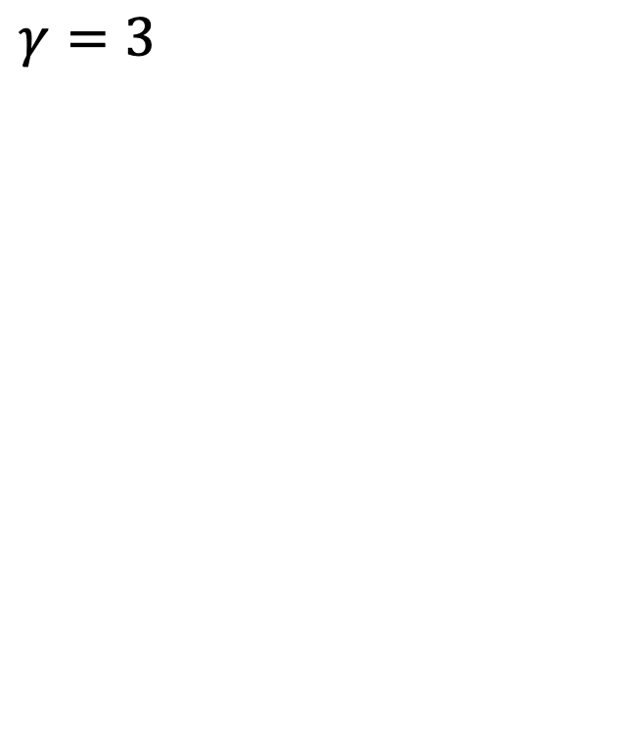
Theoretical overview: Barabasi-Albert
$${Π(k}_{i})=\frac{k_{i}}{\sum_{j}{k_{j}}}$$
$$\frac{dki}{dt}=m {Π(k}_{i})$$
$$k_{i}={m\left(\frac{t}{t_{i}}\right)}^{\frac{1}{2}}$$
$$P\left(k\right)∝k^{−γ}$$
$\sum_{j}{k_{j }≈2mt}$
$γ=3$

Slide 7
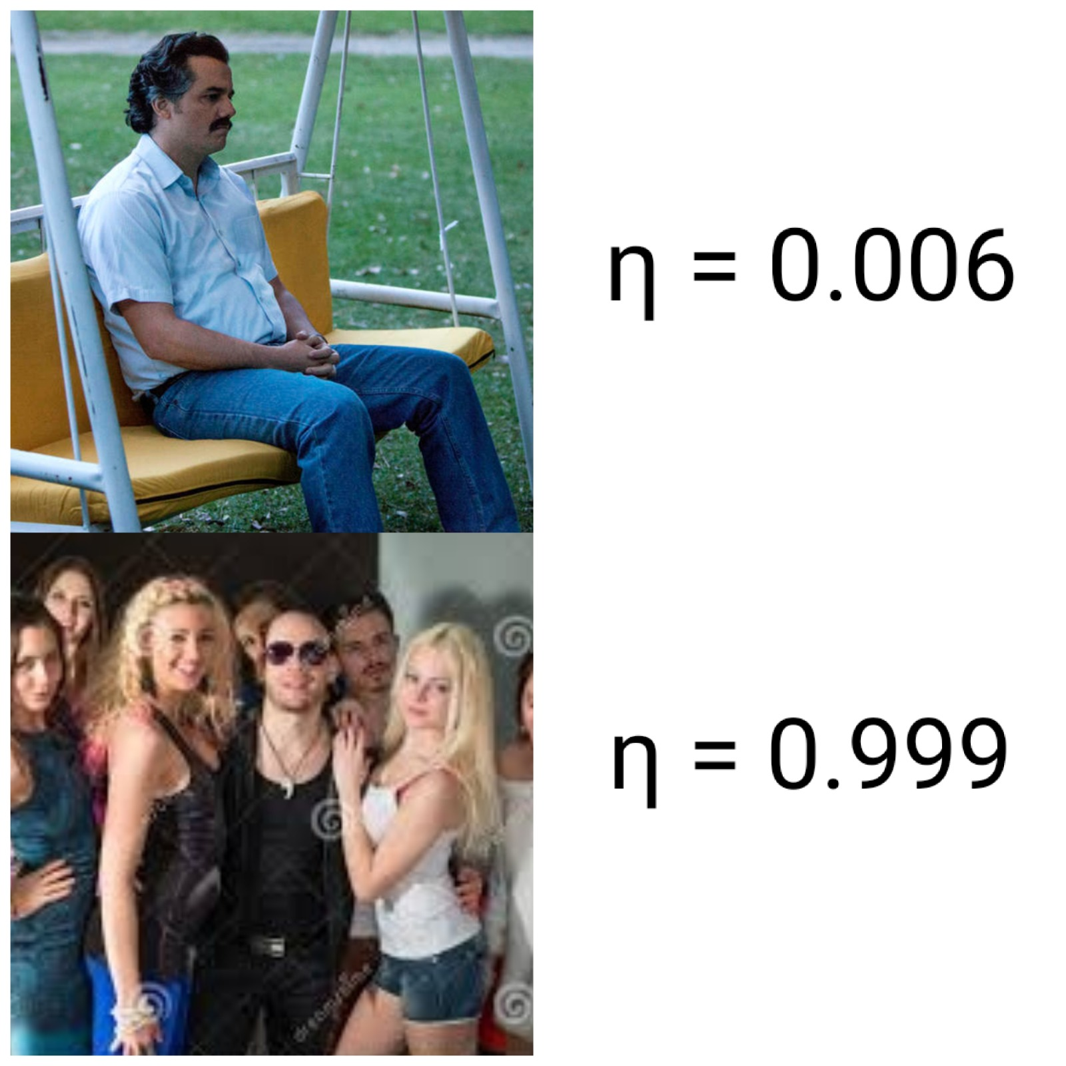
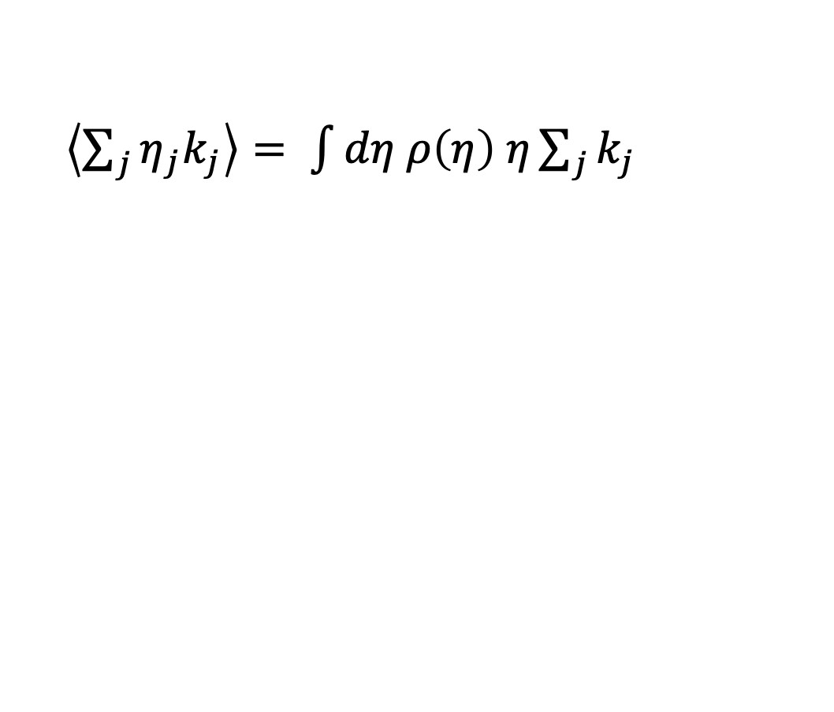
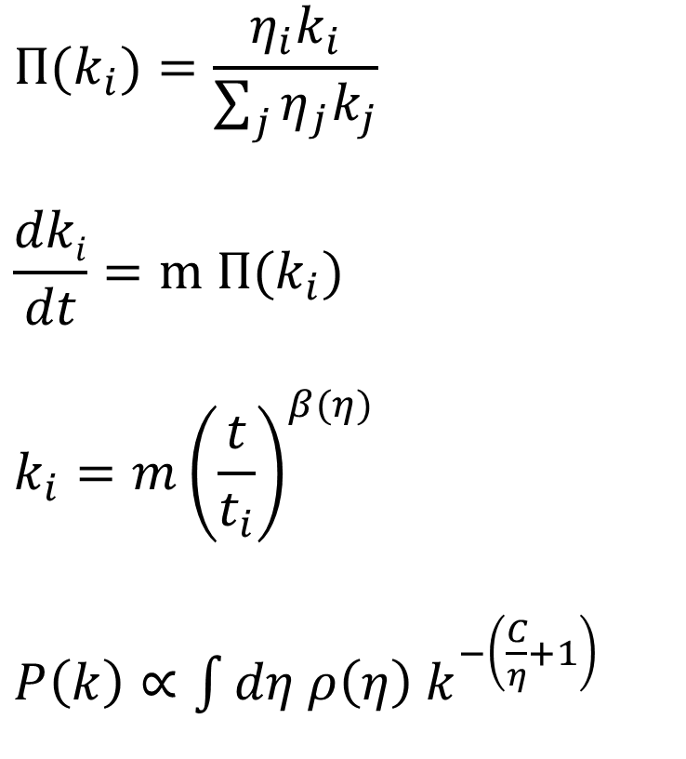
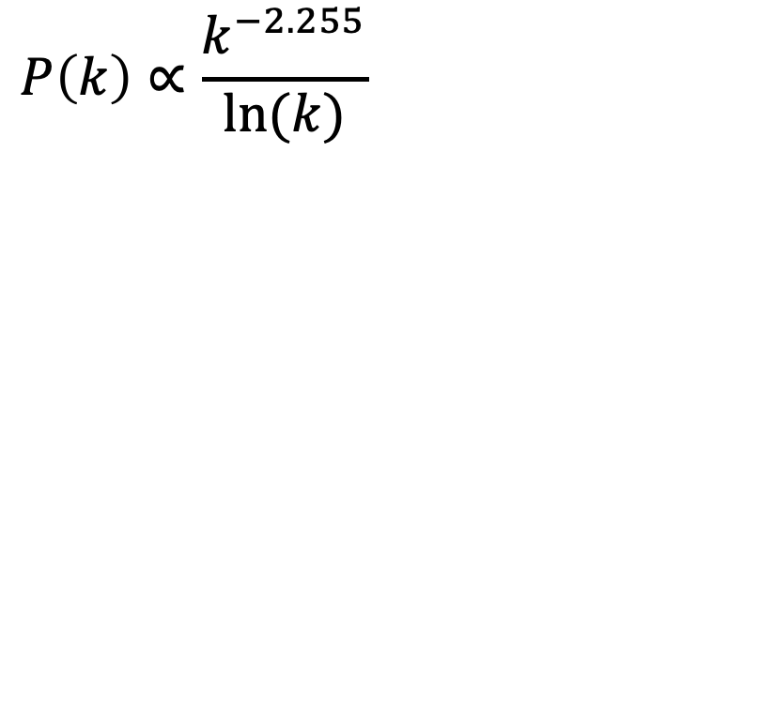
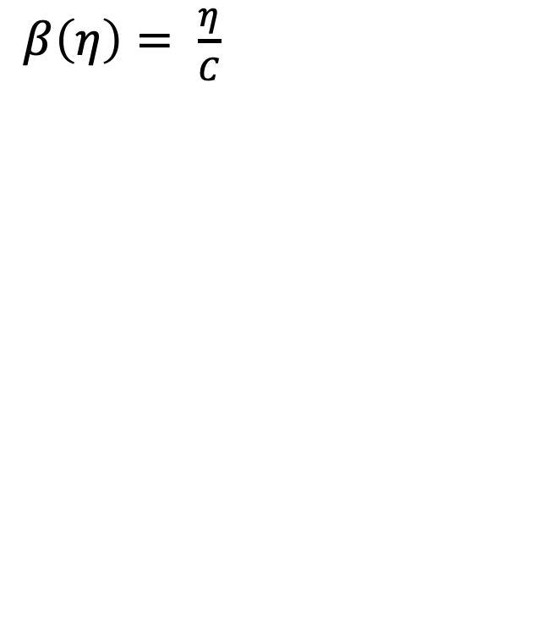
Theoretical overview: Bianconi-Barabasi
$${Π(k}_{i})=\frac{η_{i}k_{i}}{\sum_{j}{η_{j}k_{j}}}$$
$$\frac{dki}{dt}=m {Π(k}_{i})$$
$$k_{i}={m\left(\frac{t}{t_{i}}\right)}^{β(η)}$$
$P\left(k\right)∝\int{dη ρ\left(η\right) k^{−\left(\frac{C}{η}+1\right)}}$
$\left\langle \sum_{j}{η_{j}k_{j}}\right\rangle = \int{dη ρ\left(η\right) η\sum_{j}{k_{j}}}$
$β\left(η\right)= \frac{η}{C}$
$$P\left(k\right)∝\frac{k^{−2.255}}{ln⁡(k)}$$

Slide 8
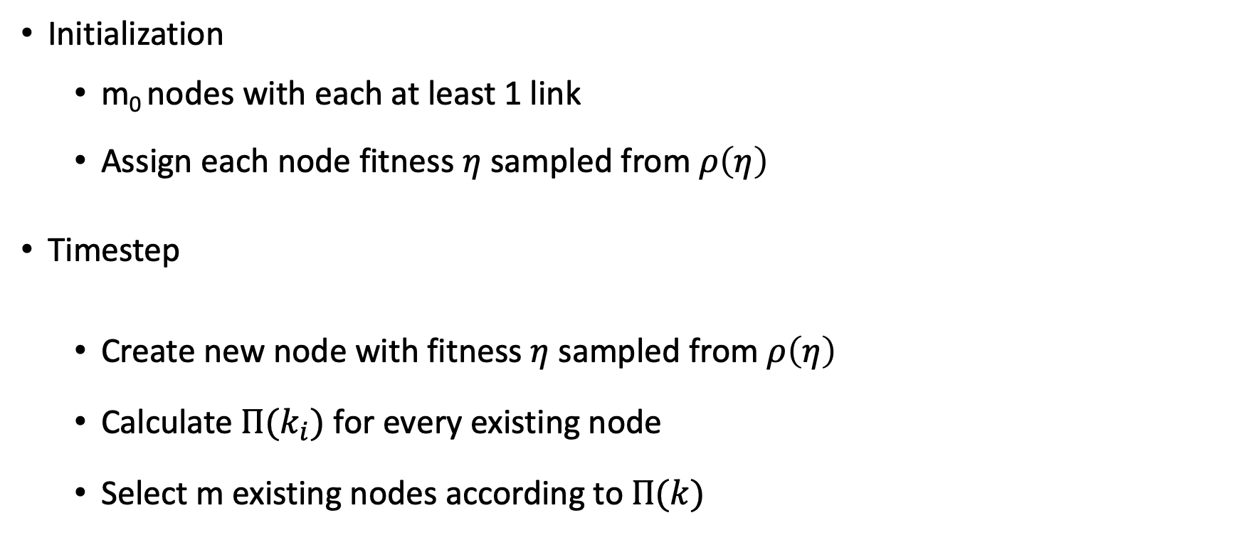
Model implementation
Initialization
m₀ nodes with each at least 1 link
Assign each node fitness $η$ sampled from $ρ\left(η\right)$
Timestep
Create new node with fitness $η$ sampled from $ρ\left(η\right)$
Calculate ${Π(k}_{i})$ for every existing node
Select m existing nodes according to$Π(k)$

Slide 9
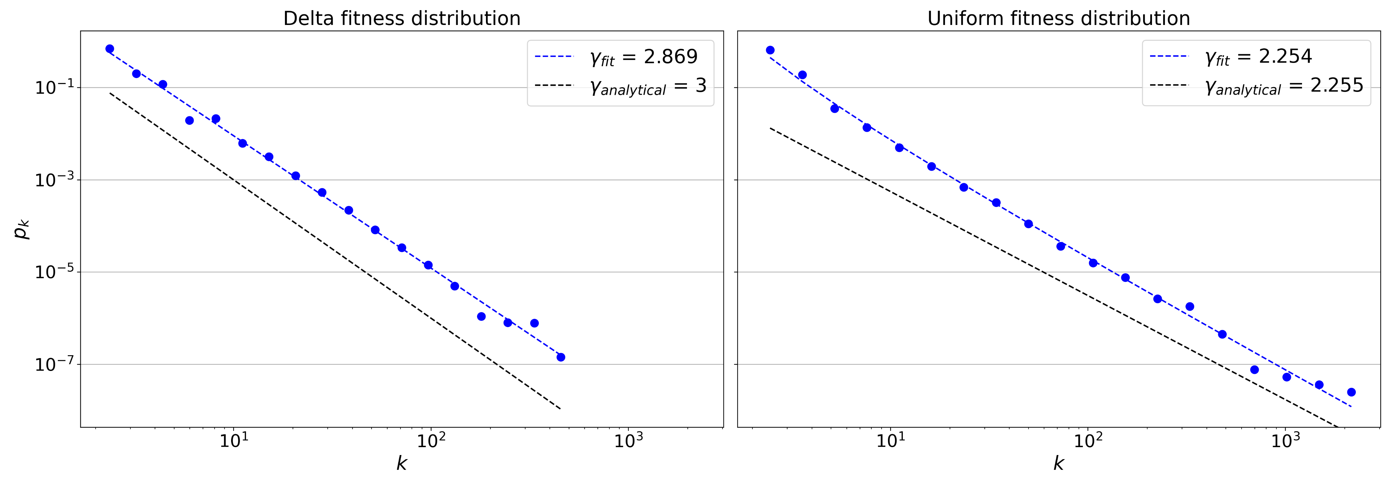
Analysis: Degree distributions

Slide 10
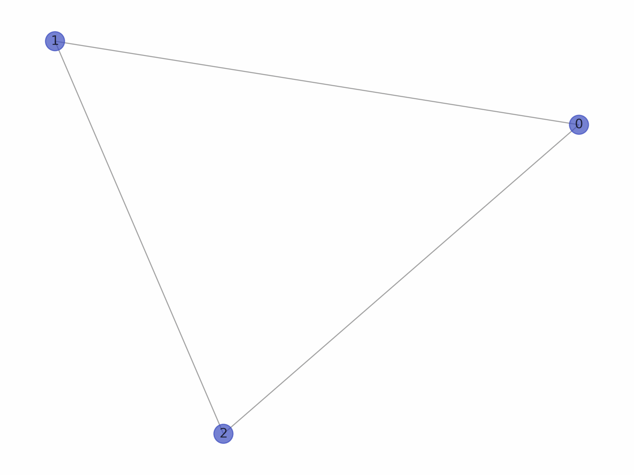
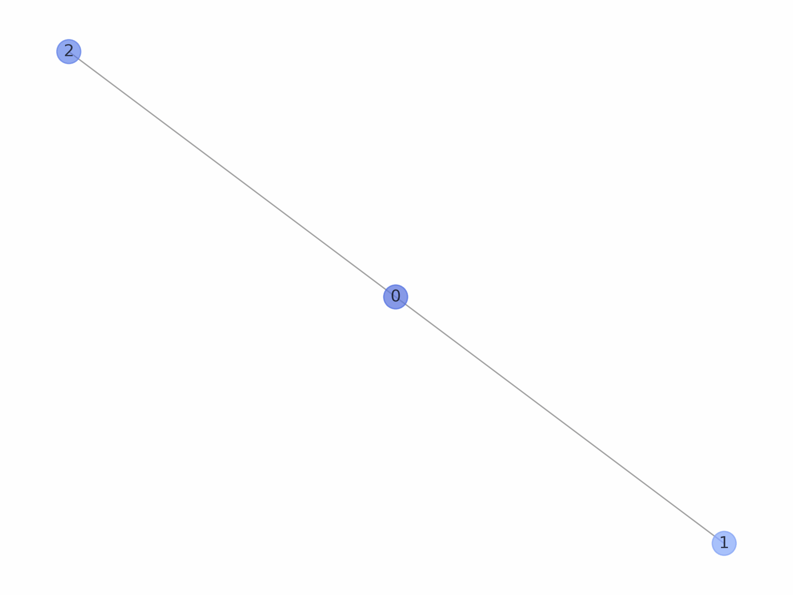
Analysis: Network visualization
Delta fitness distribution
Uniform fitness distribution

Slide 11
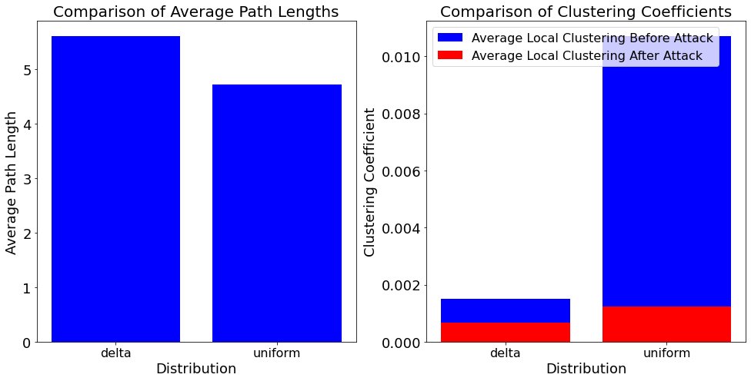
Network analysis
Analyze network:
Small work properties
Node overtaking
Robustness against attacks
 | Delta (BA-network) | Uniform (BB-network)
Degree assortativity | -0.0243 | -0.0604
Hubs | 0, 8, 2, 4, 7 | 6, 19, 8, 60 10
Connected components before attack | 1 | 1
Connected components after attack | 14 | 274

Slide 12
Delta:
Analysis: Degree distributions
 | Power law | Truncated power law | Strechted exponential | Lognormal | Exponential | Lognormal positive
Truncated powerlaw | R + Significant | --- | R+ Not significant | R+ Not significant | R+ Significant | R+ Significant
Power Law | --- | R-, Significant | R-, Not significant | R-, Not significant | R+, Significant | R+ Significant
Strechted Exponential | R+ Not significant | R-, Not significant | --- | R+ Not significant | R + Significant | R + Significant
Uniform:
 | Power law | Truncated power law | Strechted exponential | Lognormal | Exponential | Lognormal positive
Truncated powerlaw | R + Significant | --- | R+ Not significant | R+ Not significant | R+ Significant | R+ Significant
Power Law | --- | R-, Significant | R-, Not significant | R+ Not significant | R+, Significant | R+ Significant
Strechted Exponential | R+ Not significant | R-, Not significant | --- | R+ Not significant | R + Significant | R + Significant
Notes:
Delta: Calculating best minimal value for power law fit
truncated_power_law vs power_law: R = 1.6533, p = 0.0097
truncated_power_law vs lognormal: R = 2.0899, p = 0.0366
truncated_power_law vs exponential: R = 3.6583, p = 0.0003
truncated_power_law vs lognormal_positive: R = 643.4221, p = 0.0
truncated_power_law vs stretched_exponential: R = 1.7735, p = 0.0761
power_law vs lognormal: R = -0.9454, p = 0.3445
power_law vs exponential: R = 3.0434, p = 0.0023
power_law vs lognormal_positive: R = 583.1279, p = 0.0
power_law vs truncated_power_law: R = -1.6533, p = 0.0097
power_law vs stretched_exponential: R = -1.0447, p = 0.2961
strechted_exponential vs power_law: R = 1.0447, p = 0.2961
strechted_exponential vs lognormal: R = 1.2975, p = 0.1945
strechted_exponential vs exponential: R = 3.589, p = 0.0
strechted_exponential vs lognormal_positive: R = 638.3565, p = 0.0
strechted_exponential vs truncated_power_law: R = -1.7735, p = 0.0761
Uniform:
Calculating best minimal value for power law fit
truncated_power_law vs power_law: R = 1.7093, p = 0.0147
truncated_power_law vs lognormal: R = 1.1569, p = 0.2473
truncated_power_law vs exponential: R = 3.8789, p = 0.0001
truncated_power_law vs lognormal_positive: R = 621.8906, p = 0.0
truncated_power_law vs stretched_exponential: R = 0.9225, p = 0.3563
power_law vs lognormal: R = -1.1903, p = 0.2339
power_law vs exponential: R = 3.2549, p = 0.0011
power_law vs lognormal_positive: R = 567.0171, p = 0.0
power_law vs truncated_power_law: R = -1.7093, p = 0.0147
power_law vs stretched_exponential: R = -1.284, p = 0.1991
strechted_exponential vs power_law: R = 1.284, p = 0.1991
strechted_exponential vs lognormal: R = 1.1932, p = 0.2328
strechted_exponential vs exponential: R = 3.8522, p = 0.0 s
trechted_exponential vs lognormal_positive: R = 614.8755, p = 0.0
strechted_exponential vs truncated_power_law: R = -0.9225, p = 0.3563

Slide 13
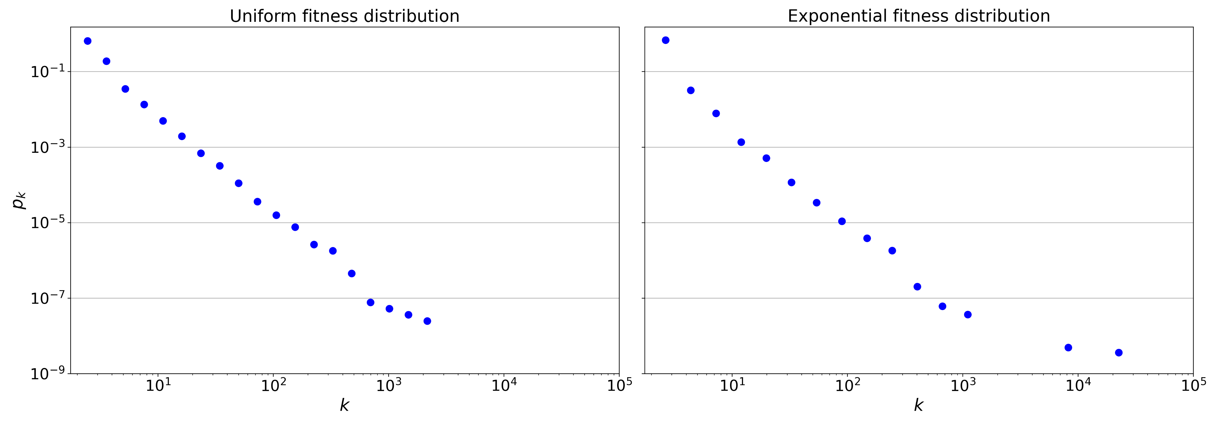
Analysis: Degree distributions

Slide 14
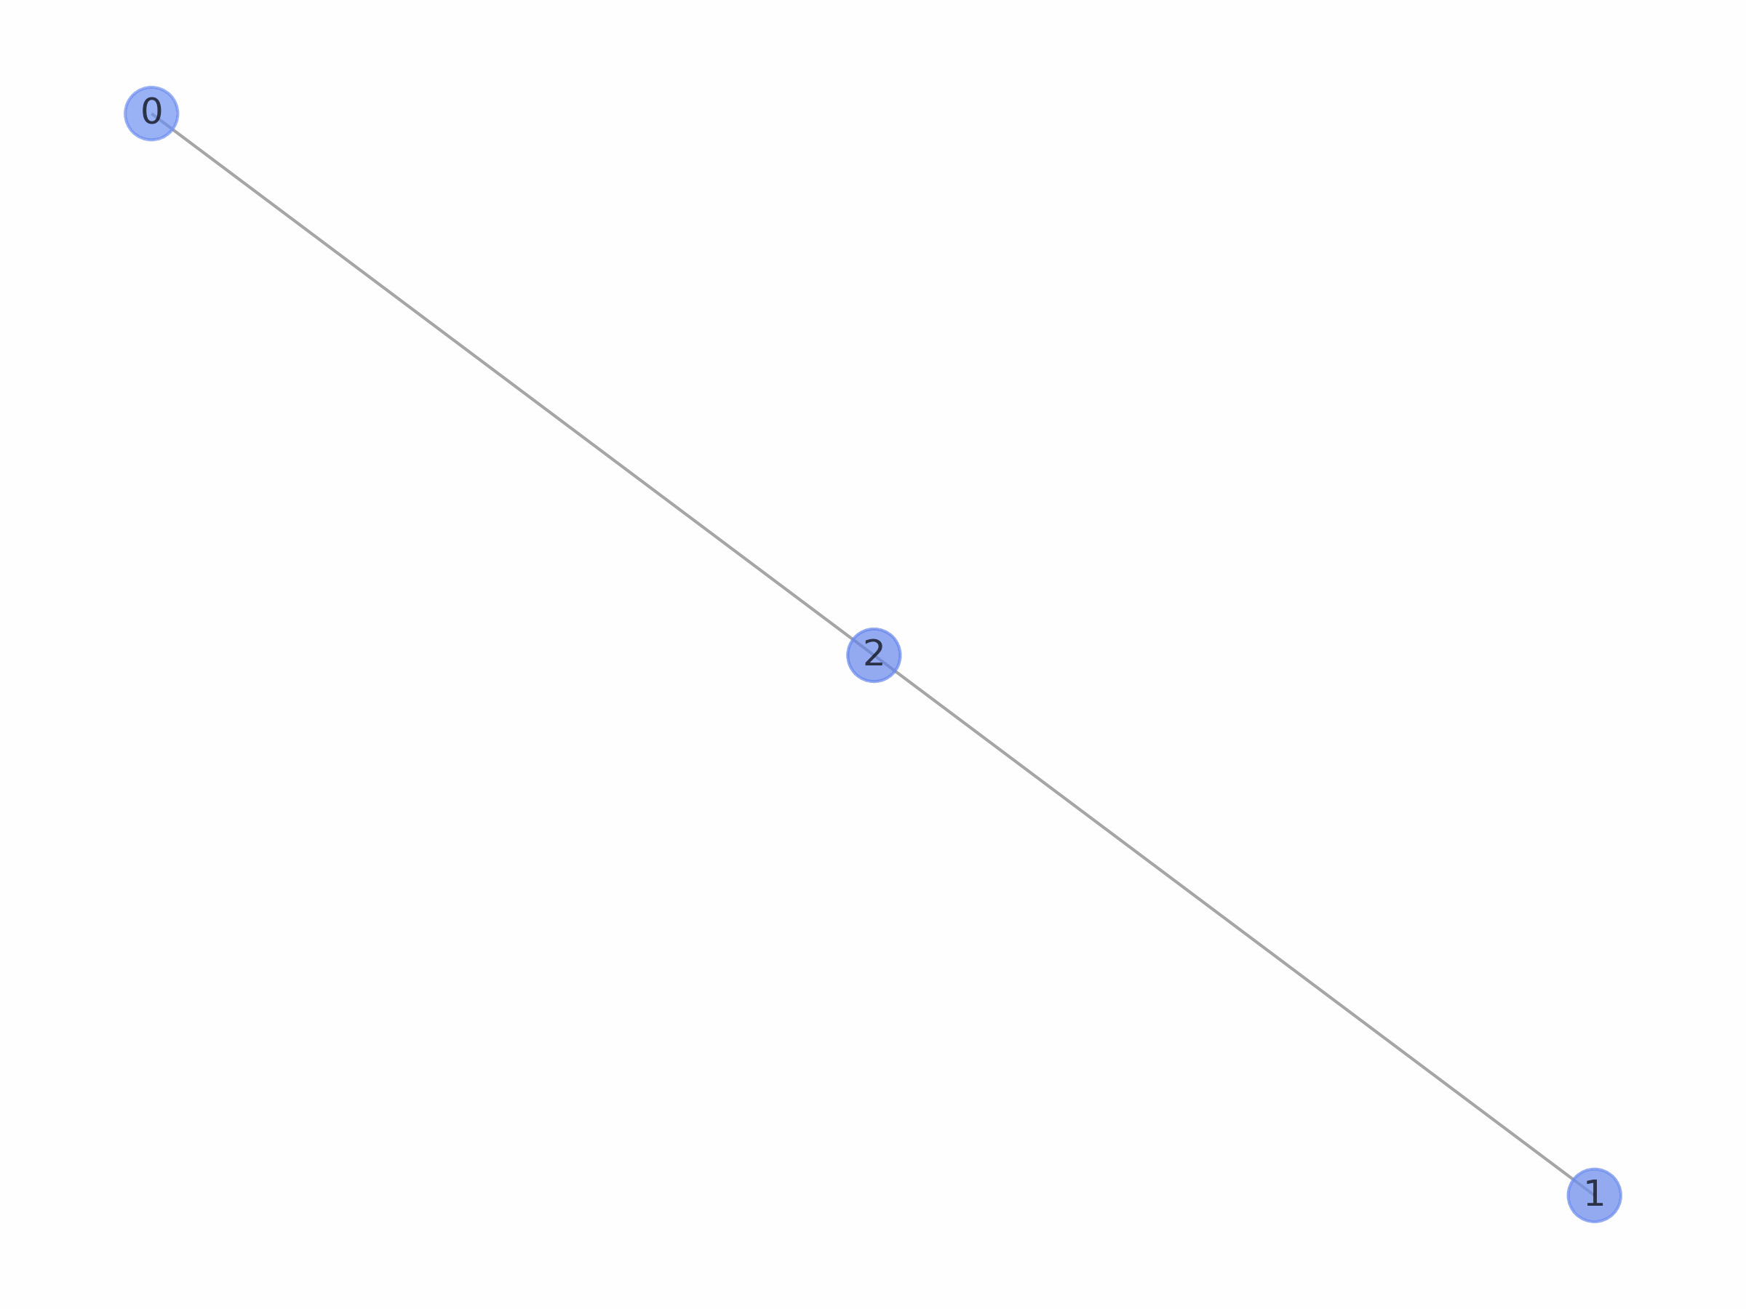
Analysis: Network visualization
Uniform fitness distribution
Exponential fitness distribution

Slide 15
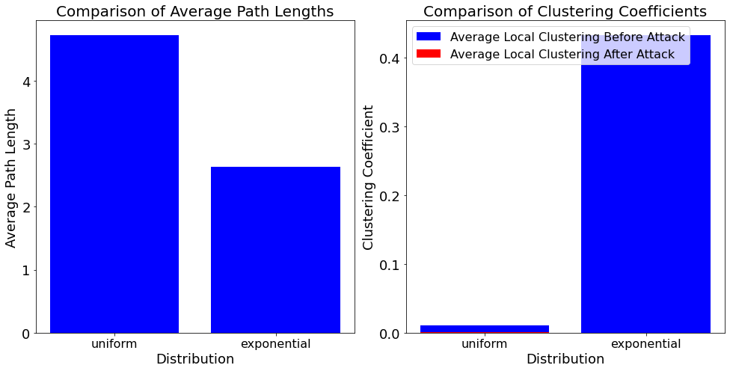
Network analysis
Analyze network:
Small work properties
Node overtaking
Robustness against attacks
 | Uniform (BB-network) | Exponential
Clustering coefficient before attack | 0.0107 | 0.4325
Clustering coefficient before attack | 0.0012 | 0.0002
Degree assortativity | -0.0604 | -0.3484
Hubs | 6, 19, 8, 60 10 | 18, 12, 73, 29, 24
Connected components before attack | 1 | 1
Connected components after attack | 274 | 13839

Slide 16
Uniform:
Analysis: Degree distributions
 | Power law | Truncated power law | Strechted exponential | Lognormal | Exponential | Lognormal positive
Truncated powerlaw | R + Significant | --- | R+ Not significant | R+ Not significant | R+ Significant | R+ Significant
Power Law | --- | R-, Significant | R-, Not significant | R+ Not significant | R+, Significant | R+ Significant
Strechted Exponential | R+ Not significant | R-, Not significant | --- | R+ Not significant | R + Significant | R + Significant
Exponential:
 | Power law | Truncated power law | Strechted exponential | Lognormal | Exponential | Lognormal positive
Truncated powerlaw | R + Significant | ---- | R+ Not significant | R+ Not significant | R+ Significant | R+ Significant
Power Law | --- | R-, Significant | R-, Not significant | R+ Not significant | R+, Significant | R+ Significant
Strechted Exponential | R+ Not significant | R-, Not significant | --- | R+ Not significant | R + Significant | R + Significant
Notes:
Uniform:
Calculating best minimal value for power law fit
truncated_power_law vs power_law: R = 1.7093, p = 0.0147
truncated_power_law vs lognormal: R = 1.1569, p = 0.2473
truncated_power_law vs exponential: R = 3.8789, p = 0.0001
truncated_power_law vs lognormal_positive: R = 621.8906, p = 0.0
truncated_power_law vs stretched_exponential: R = 0.9225, p = 0.3563
power_law vs lognormal: R = -1.1903, p = 0.2339
power_law vs exponential: R = 3.2549, p = 0.0011
power_law vs lognormal_positive: R = 567.0171, p = 0.0
power_law vs truncated_power_law: R = -1.7093, p = 0.0147
power_law vs stretched_exponential: R = -1.284, p = 0.1991
strechted_exponential vs power_law: R = 1.284, p = 0.1991
strechted_exponential vs lognormal: R = 1.1932, p = 0.2328
strechted_exponential vs exponential: R = 3.8522, p = 0.0 s
trechted_exponential vs lognormal_positive: R = 614.8755, p = 0.0
strechted_exponential vs truncated_power_law: R = -0.9225, p = 0.3563
Exponential
Calculating best minimal value for power law fit
truncated_power_law vs power_law: R = 1.0877, p = 0.1441
truncated_power_law vs lognormal: R = 1.1135, p = 0.2655
truncated_power_law vs exponential: R = 3.6457, p = 0.0003
truncated_power_law vs lognormal_positive: R = 512.1677, p = 0.0
truncated_power_law vs stretched_exponential: R = 0.9372, p = 0.3486
power_law vs lognormal: R = -0.6012, p = 0.5477
power_law vs exponential: R = 3.2553, p = 0.0011
power_law vs lognormal_positive: R = 479.4889, p = 0.0
power_law vs truncated_power_law: R = -1.0877, p = 0.1441
power_law vs stretched_exponential: R = -0.6505, p = 0.5154
strechted_exponential vs power_law: R = 0.6505, p = 0.5154
strechted_exponential vs lognormal: R = 0.8009, p = 0.4232
strechted_exponential vs exponential: R = 3.6279, p = 0.0
strechted_exponential vs lognormal_positive: R = 505.9862, p = 0.0
strechted_exponential vs truncated_power_law: R = -0.9372, p = 0.3486

Slide 17
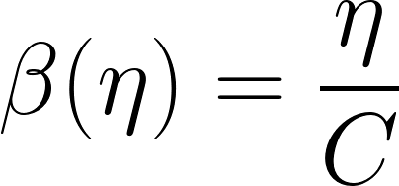
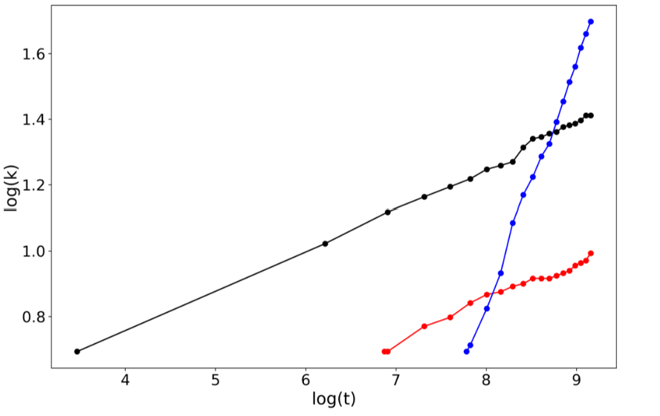
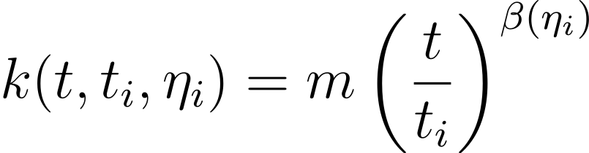
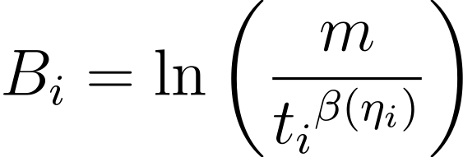
Fitness Estimation
Linear relation -> Linear regression

Slide 18
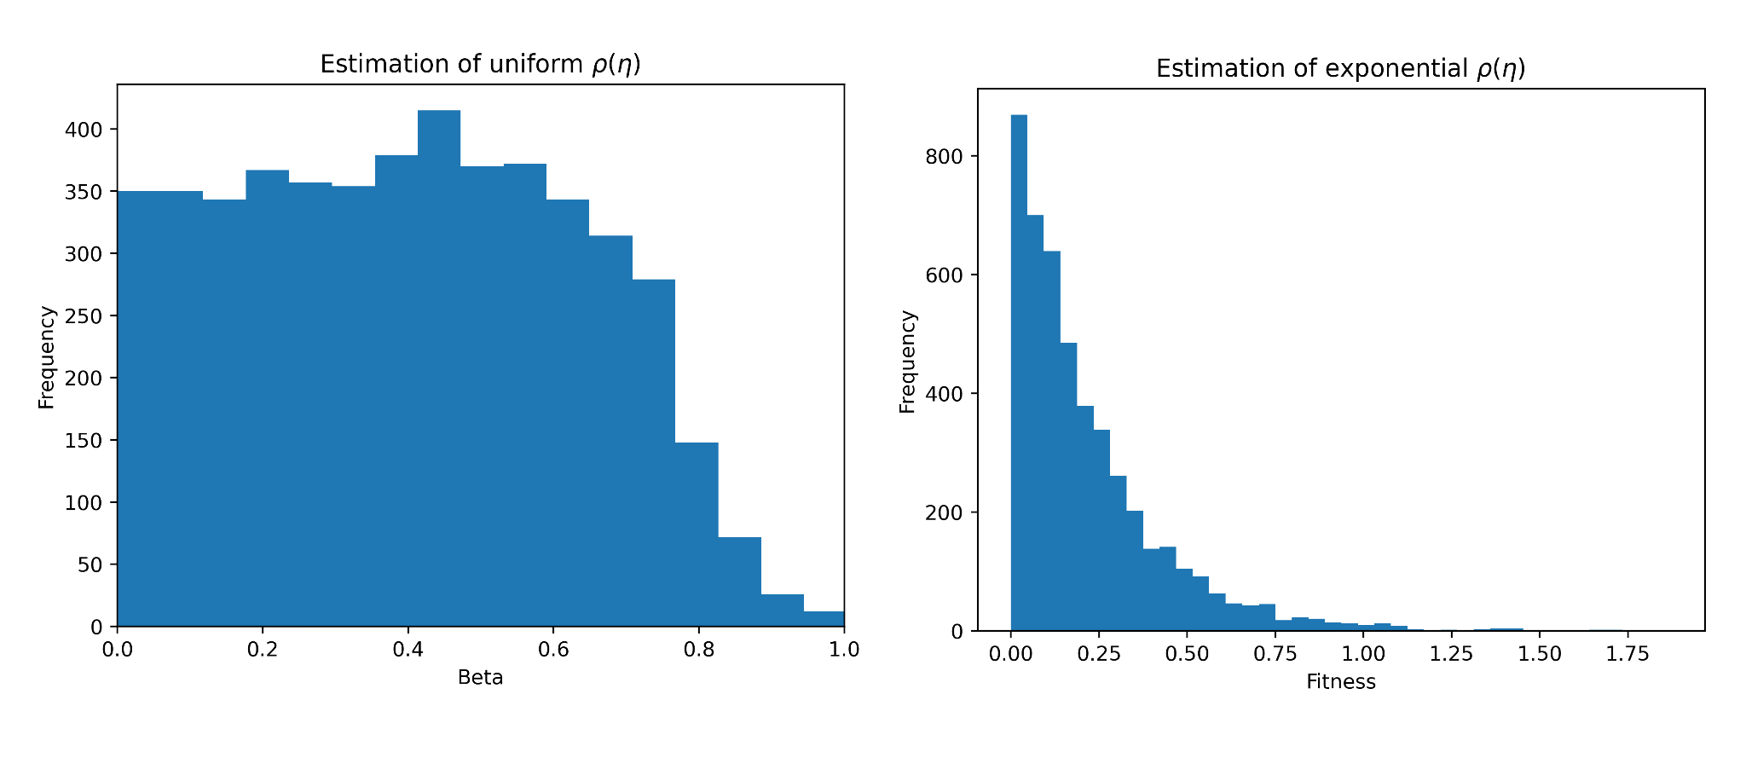
Fitness Estimation Results

Slide 19
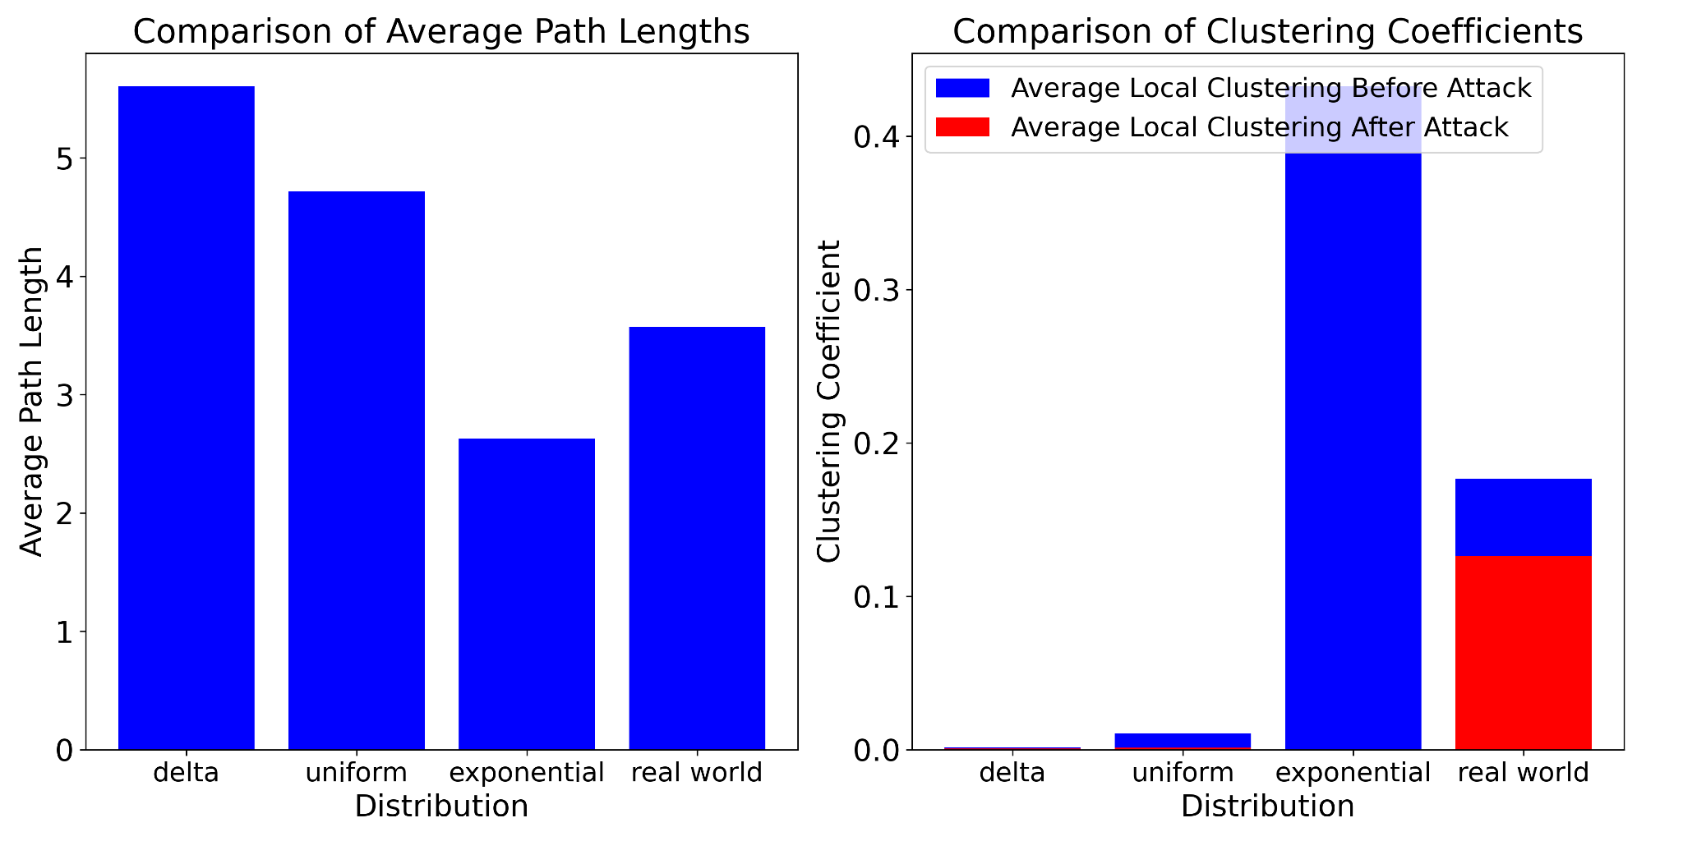
Real data
Analyze network:
Small work properties
Node overtaking
Robustness against attacks
 | Uniform (BB-network) | Exponential | Real World Network
Degree assortativity | -0.0604 | -0.3484 | -0.1685
Hubs | 6, 19, 8, 60 10 | 18, 12, 73, 29, 24 | 1,8,3,2,11
Connected components before attack | 1 | 1 | 5
Connected components after attack | 274 | 13839 | 338

Slide 20
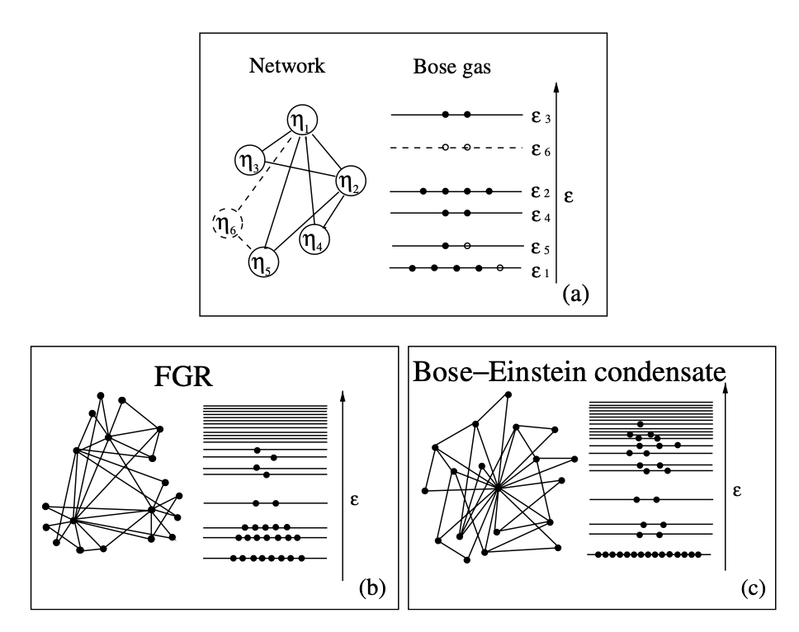
Phase transition: Bose-Einstein condensation
Bianconi, G., & Barabási, A. L. (2001). Bose-Einstein condensation in complex networks. Physical review letters, 86(24), 5632.

Slide 21
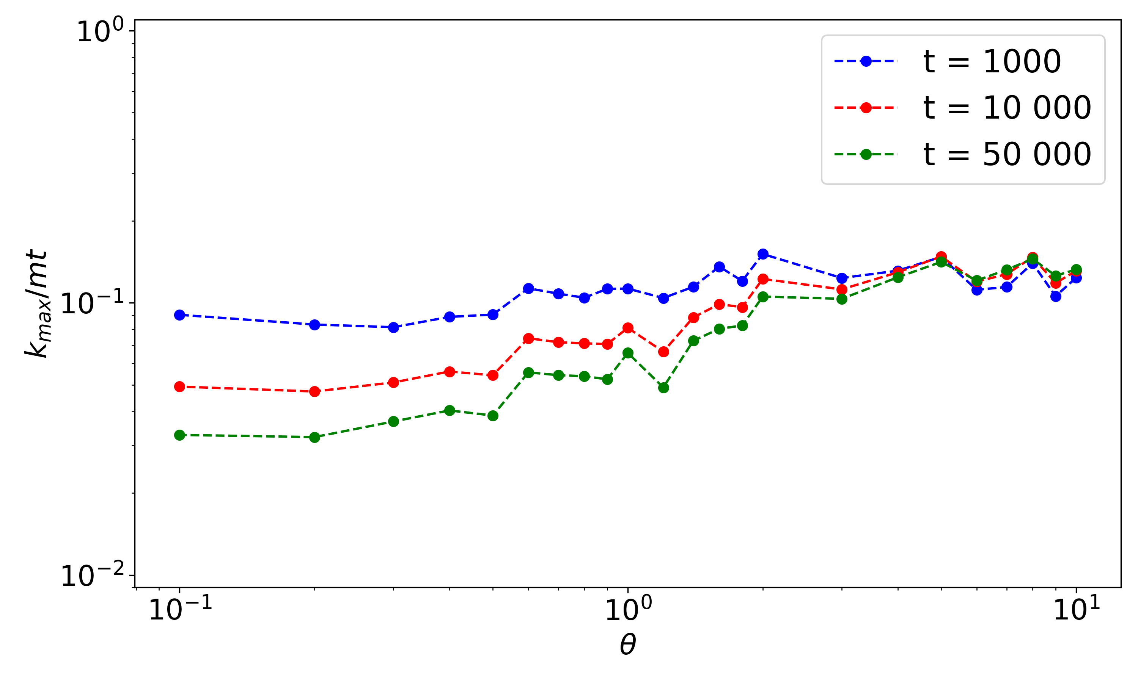
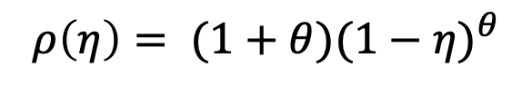
Phase transition: Bose-Einstein condensation
$$ρ\left(η\right)= (1+θ){(1−η)}^{θ}$$

Slide 22
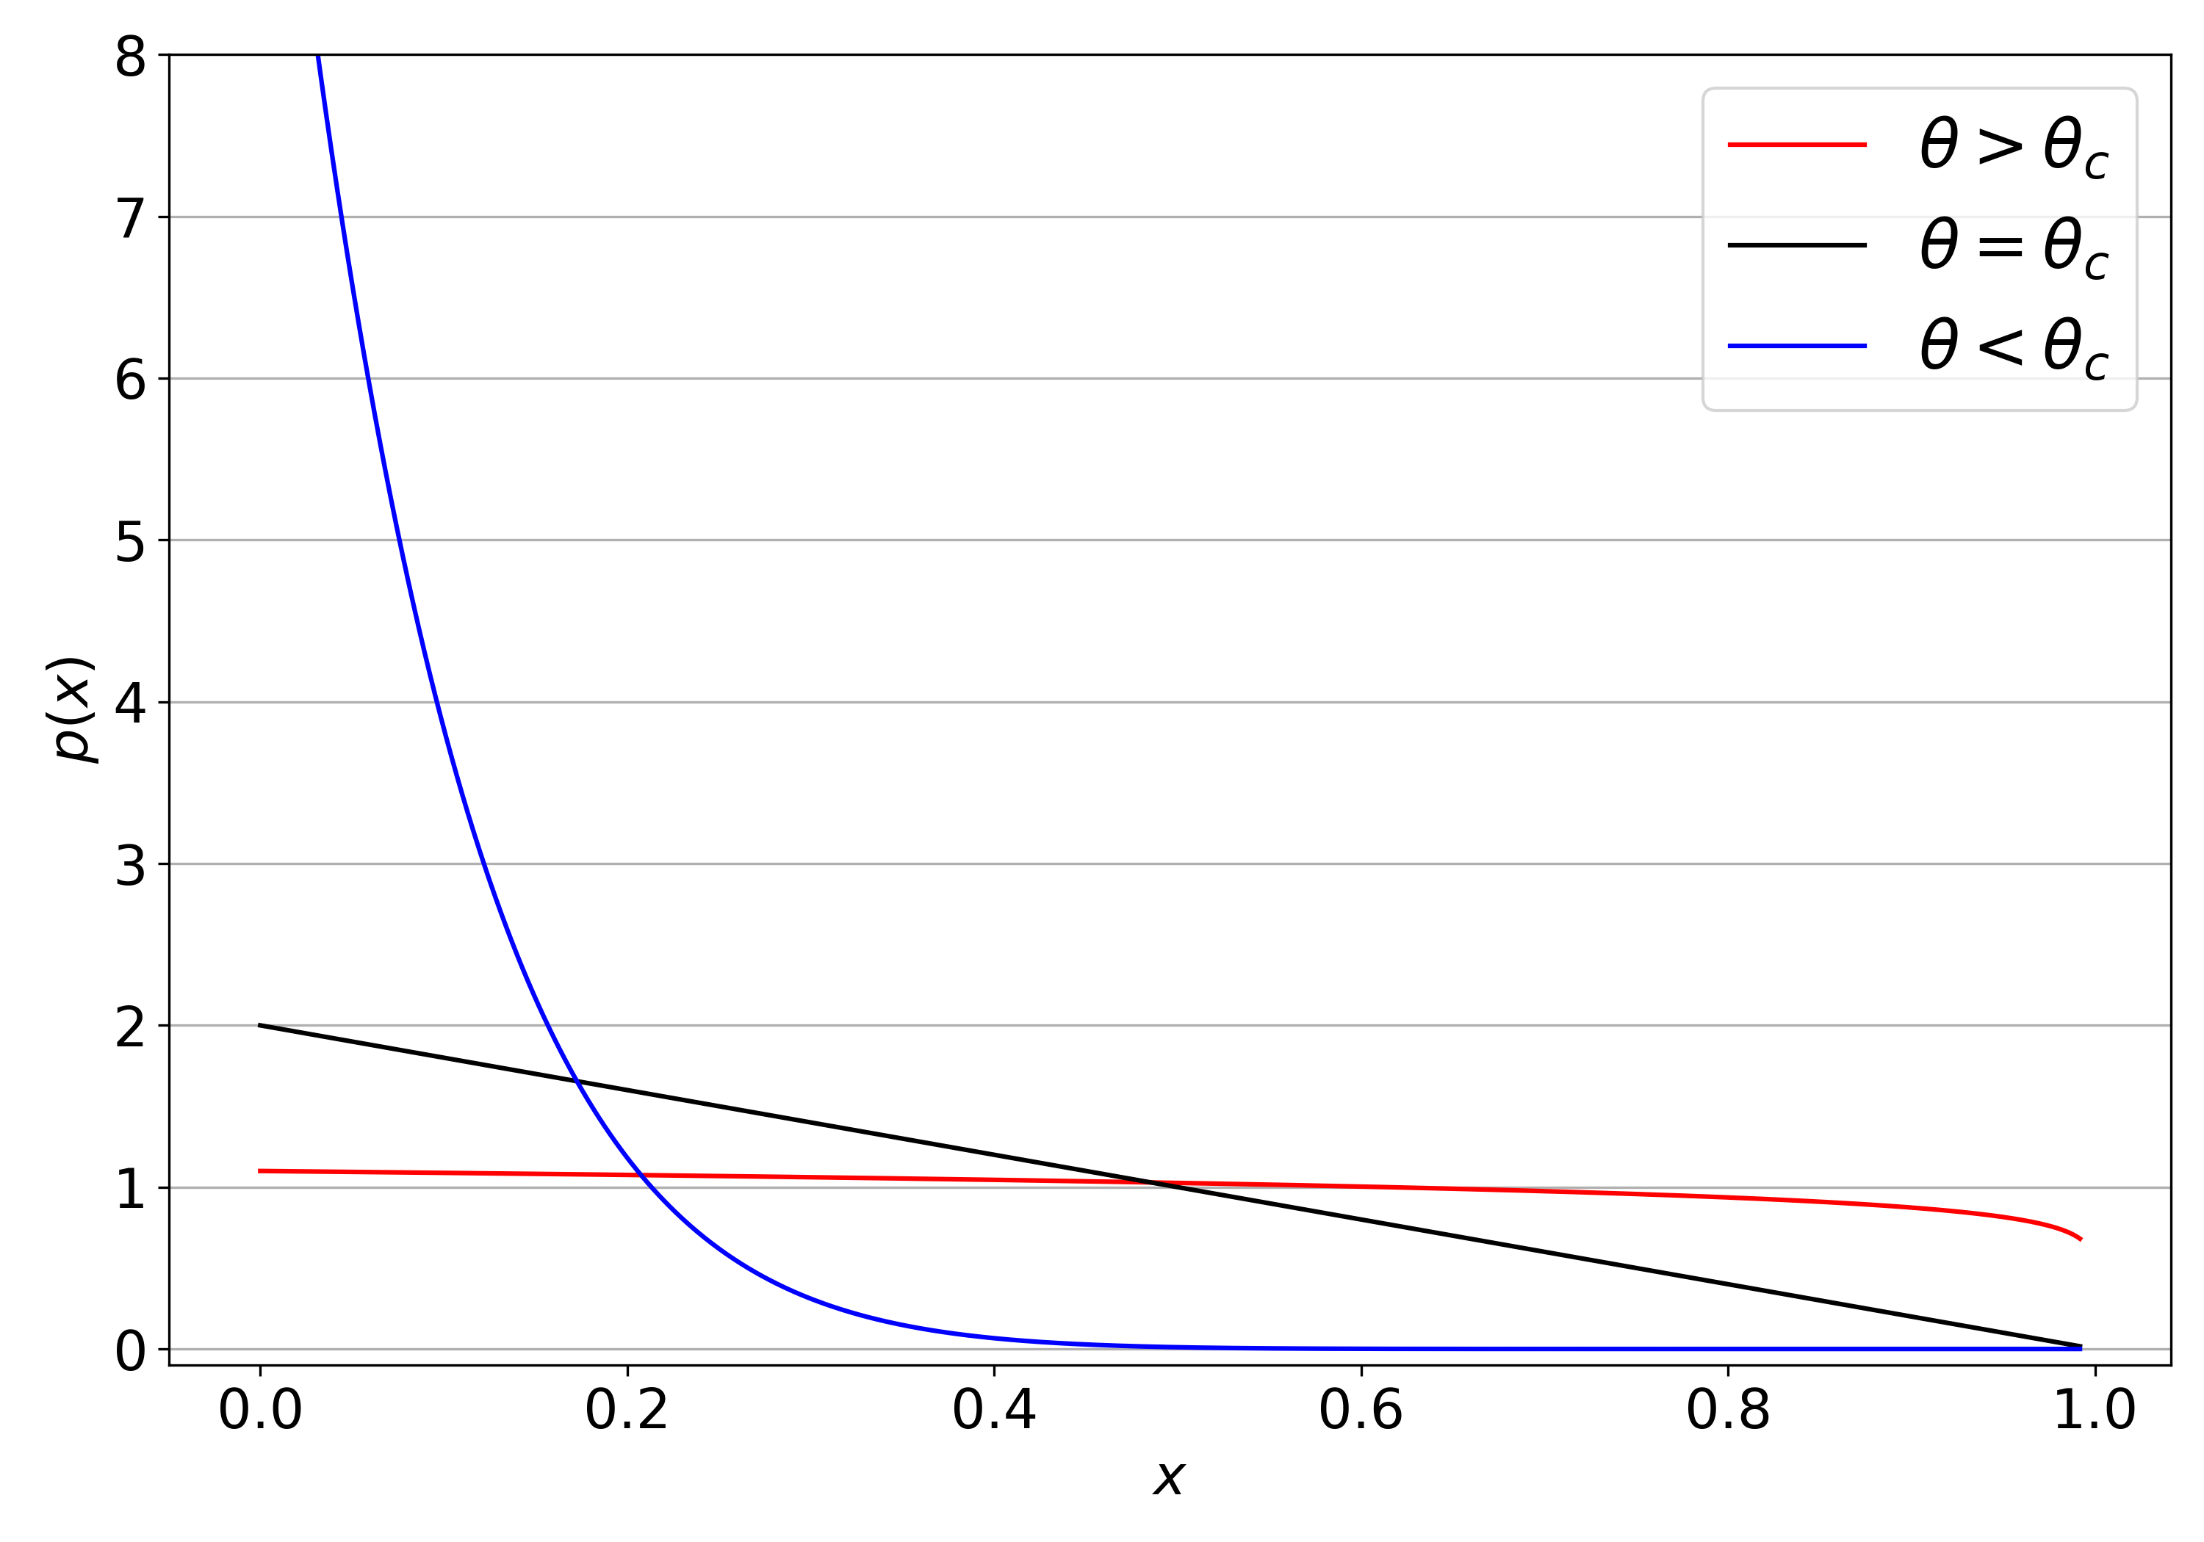
Phase transition: Bose-Einstein condensation

Slide 23
Conclusions

Slide 24
Questions

